Slide 1
Title I Annual Parent Meeting
Richard L. Sanders School
Thursday, August 31, 2023
5:30 pm
Media Center
Heidi D’Ambrosio

Slide 2
All About Title I
Title I is the largest federal assistance program for our nation’s schools.
The program serves 85 schools in Pinellas County including eligible students in 36 non-public schools.
Notes:
Highlight the Title I Program here in Pinellas County.

Slide 3
Title I Funding Process
2. Florida Department of Education
1. Federal Government
3. Pinellas County Schools
4. Richard L. Sanders School
Notes:
The Florida Department of Education receives funds from the federal government. Districts receive Title I funds from Department of Education, and the school district distributes these funds to schools based on the percentage of children eligible for free/reduced price lunch; however, students do not have to be from low-income families to receive help.

Slide 4
Title I Supplemental Resources
Definition: provided in addition to what is already present or available to complete or enhance it.
https://languages.oup.com/

Slide 5
Examples of Supplemental Materials
Educational Posters
Educational games
Individual Student Materials
Supplemental Books
Sensory Items
Science experiment materials
Math Manipulatives

Slide 6
Title I Schoolwide Planning and Input
First
Second
Last
Seek Input from school, family, and community members determine how Title I funds are used based on a needs assessment.
Please attend online or in-person meetings/trainings and complete surveys to provide input on Title I funding.
All Title I schools must document that parents are involved in the schoolwide planning process.
Notes:
Evidence for input – input from school can be a survey or notes, which include quotes related to what was shared as feedback AND how this input will be used to inform the PFEP and future engagement activities.
Evidence of Attendance – please include attendance of DIVERSE stakeholder group/s.

Slide 7
Title I Schoolwide Budget
Richard L. Sanders School is provided $49,400 to pay for supplemental resources and programs for increased student achievement and Family Engagement $7,850.

Slide 8
Parent’s Right to Know
As a parent of a student attending a Pinellas County School Public School, you have the right to…
Be
Be provided information on your child’s level of achievement on assessments in Reading/Language Arts, Writing, Mathematics, and Science.
Request and receive information on the qualifications of your child’s teacher and supplemental personnel working with your child.
Be
Be notified of non-highly qualified or out-of-field teachers at the school.
Be
Be informed if your child is taught by a non-highly qualified teacher for four or more consecutive weeks.

Slide 9
Working Together for Student Success
School
School Improvement Plan (SIP)
Title
Title I Schoolwide Plan
Parent
Parent and Family Engagement Plan
School
School-Parent-Student Compact
Notes:
As a Title I parent you have the right to be involved in the development of the following plans and documents for our school which can be found on our website (insert website) to view as well as in the Parent Station located (insert location here).
Our school’s Title I Parent Station is located (insert location or photo of Title I Parent Station (front office and on the webpage). Please include photo as part of the evidence monitoring.
You will find a copy of our School Improvement Plan, Title I Schoolwide Plan, School’s PFEP, the School District’s PFEP, Parent’s Right to Know Memo, Upcoming Events, Compact, (insert other documents at your station)
School Improvement Plan (SIP)
Parent and Family Engagement Plan
Title I Schoolwide Plan
School-Parent-Student Compact

Slide 10
Parent-School-Student Compact
The purpose of the compact is to foster student achievement. By signing the Parent-School-Student Compact, (Insert name of school here), teachers, staff, parents and students agree to work together to share the responsibility of helping students meet or exceed state, district and school academic goals.
The Parent-School-Student Compact is updated every year to include parent, student, teacher, and staff input. Parent, student, teacher and staff comments are welcome at any time during the year.
Please review and sign your child’s Compact.
Our goal is to receive 100% signed compacts!
Notes:
At the elementary level, school compacts are used as a progress monitoring tool through the year during parent teacher conferences.

Slide 11
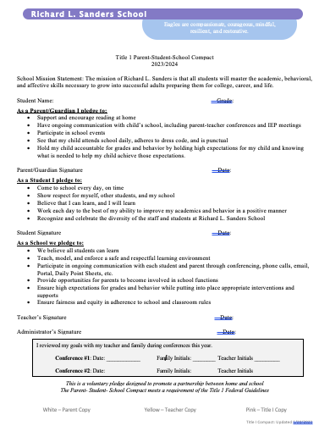
Notes:
Please insert the an example of your updated school compact. Highlight any things that unique to your school’s compact.

Slide 12
Parent and Family Engagement Plan (PFEP)
The PFEP Sections include information about the following:
Parent trainings to increase student achievement
Staff trainings for engaging parents
Communication methods between home and school
Flexible meeting times
Accessibility for parents
Coordinating with other Federal Programs
Notes:
Provide information on the specific committees that parents can be involved. Include the purpose, date and time of meetings.
Explain the PFEP and its purpose.
Consider the evidence related Title I Crate, Sample of Evidence,

Slide 13
Florida Benchmark For Excellent Student Thinking Standards (B.E.S.T). You may read more information by visiting, www.fldoe.org.
Progress Monitoring 3 times per year.
Florida End of Course (EOC) Assessments (Algebra 1, Biology, Civics, U.S. History, Geometry)
To learn more about state assessments visit the Florida Department of Education’s website, fldoe.org/accountability/assessments.
Notes:
All curriculum, instruction and assessments are based on student-centered expectations.

Slide 14
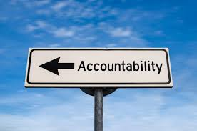
Accountability
School Report Cards
School Grade and Overview
Population and Enrollment
Assessments – Academic Achievement, Growth, and Population
Assessments – English Language Learners
Graduation and Beyond
Educator Qualifications and Equity
Long-Term Goals and Interim Progress
Accelerated Course Enrollment
Per-Pupil Expenditures
National Data
Available online at https://edudata.fldoe.org/ or Front Office

Slide 15
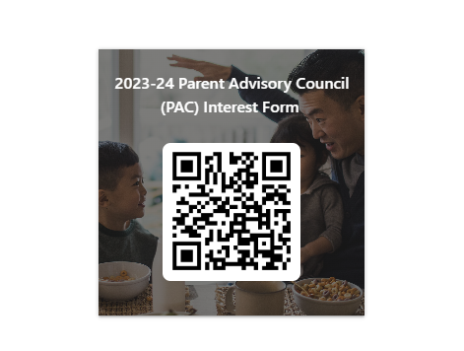
Parent Advisory Council (PAC)
The District has a Parent and Family Engagement Plan. The summary of the plan is in the Title I School & Family Partnership Overview.
You may access the full plan at www.pcsb.org/titleone
The Parent Advisory Council (PAC) is responsible for reviewing and revising the District PFEP.
PAC will meet virtually or in-person with the district’s Title I staff.
Each school is committed to having at least one member representative on PAC.
PAC meets twice a year, if you are interested in representing our school please notify, Insert contact person
Notes:
Please add your PAC representative in slide and share with your Title I Specialist.
https://forms.office.com/r/r5daaMTENE\

Slide 16
Art and Literacy Night – November 30, 2023 at 5:30 pm
SAC meetings – 3rd Tuesday, every other month, September 19, 2023 at 9:00 am
Parent Academy Webinars….TBD

Slide 17
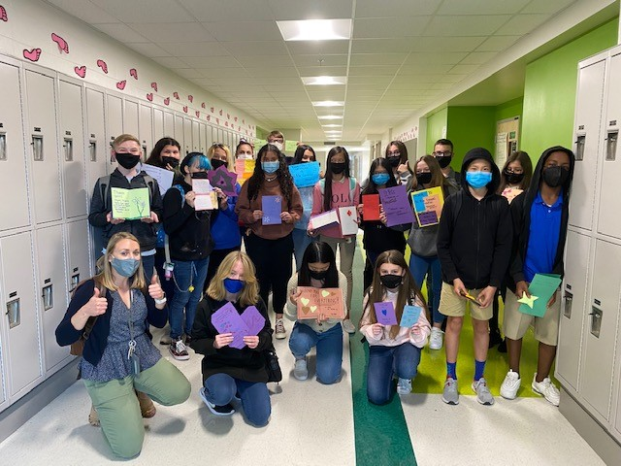
Additional Resources
Learning at Home Family Resources - https://www.pcsb.org/Page/32836
Volunteer in a Pinellas County School - https://www.pcsb.org/Page/459
Parent Academy POWER HOURS Webinars - https://www.pcsb.org/Page/26534
Partnerships - https://www.pcsb.org/Page/418

Slide 18
Thank you for your time!

Slide 19
Contact Us
5025 76th Avenue North
Pinellas Park, FL 33781
(727) 547-7728
dambrosioh@pcsb.org
Your feedback is greatly appreciated!

Slide 20
Annotating Text to Deepen Understanding
Ms. Flowers
Reading Interventionist

Slide 21
Annotation What is it?

Slide 22
Annotation is a note of any form made while reading text.
http://dictionary.reference.com/browse/notation?s=t
“Reading with a pencil.”

Slide 23
Why do we need it?

Slide 24
Annotation slows down the reader in order to deepen understanding.

Slide 25
Why Mark On The Text?
When students put things in their own words, they are more likely to remember the information.
It is meant to be an interactive note-taker.

Slide 26
What does that look like 3rd-12th grade

Slide 27
Annotations in Grades 3-5
Underline key words / phrases.
Circle unknown words that make the reading confusing
Write a question mark (?) for questions that you have during reading. AND write your question near the text.

Slide 28
T. Modeled Annotation in 2nd gr.
Harvey, S., & Goudvis, A. (2007). Strategies That Work: Teaching Comprehension for Understanding and Engagement. Portland, ME: Stenhouse.

Slide 29
Annotation in Grades 6-8
Underline key words and phrases
Circle unknown words that make the reading confusing
Use a question mark (?) for questions that you have while reading AND write your question near the text.
Use an exclamation mark (!) for things that surprise you, and briefly note what caught your attention.
Draw an arrow when making a connection to an idea or personal experience AND note your connections.

Slide 30
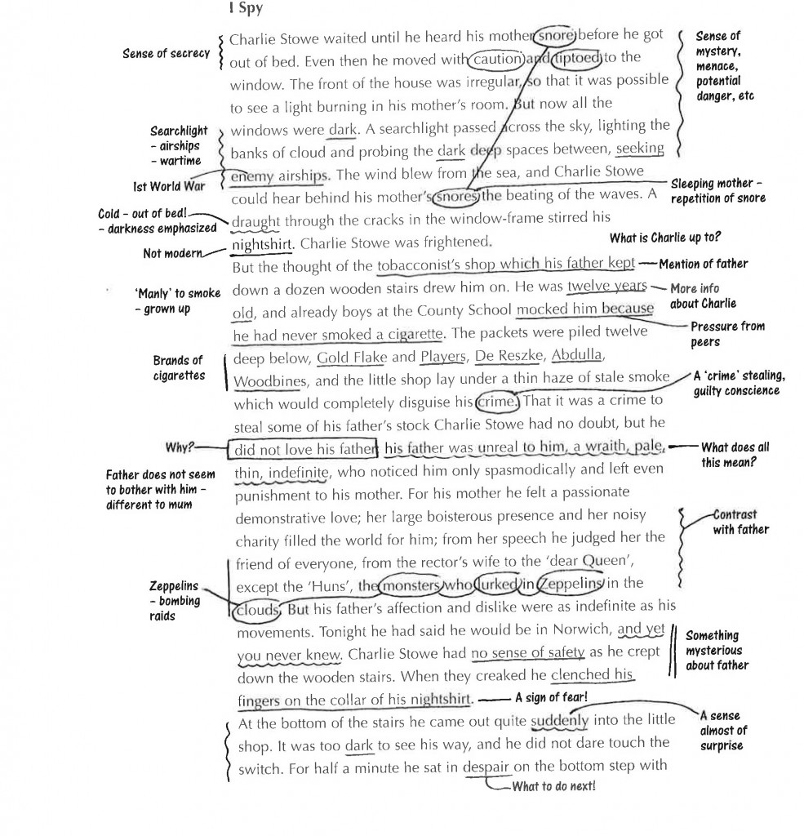
T. modeled Annotation in 7th gr.

Slide 31
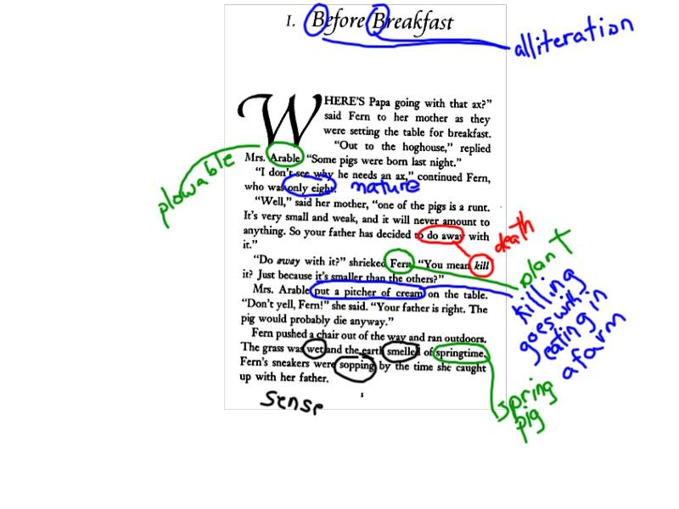
Middle school student’s annotation of connotative meanings in Charlotte’s Web
Notes:
It’s not always about reading difficult texts, but also about reading seemingly simpler texts in more complex ways.

Slide 32
Annotation in Grades 9-12
Underline the major points.
Circle keywords or phrases that are confusing or unknown to you.
Use a question mark (?) for questions that you have during the reading. Be sure to write your question.
Use an exclamation mark (!) for things that surprise you, and briefly note what it was that caught your attention.
Draw an arrow when making a connection to something with an idea or experience. Note your connections.
Mark EX when the author provides an example.
Number arguments, important ideas, or key details and write words or phrases that restate them.

Slide 33
Annotations in Grades 3-5
Underline key words / phrases.
Circle unknown words that make the reading confusing
Write a question mark (?) for questions that you have during reading. AND write your question near the text.

Slide 34
T. Modeled Annotation in 2nd gr.
Harvey, S., & Goudvis, A. (2007). Strategies That Work: Teaching Comprehension for Understanding and Engagement. Portland, ME: Stenhouse.

Slide 35
Annotation in Grades 6-8
Underline key words and phrases
Circle unknown words that make the reading confusing
Use a question mark (?) for questions that you have while reading AND write your question near the text.
Use an exclamation mark (!) for things that surprise you, and briefly note what caught your attention.
Draw an arrow when making a connection to an idea or personal experience AND note your connections.

Slide 36
T. modeled Annotation in 7th gr.

Slide 37
Middle school student’s annotation of connotative meanings in Charlotte’s Web
Notes:
It’s not always about reading difficult texts, but also about reading seemingly simpler texts in more complex ways.

Slide 38
Annotation in Grades 9-12
Underline the major points.
Circle keywords or phrases that are confusing or unknown to you.
Use a question mark (?) for questions that you have during the reading. Be sure to write your question.
Use an exclamation mark (!) for things that surprise you, and briefly note what it was that caught your attention.
Draw an arrow when making a connection to something with an idea or experience. Note your connections.
Mark EX when the author provides an example.
Number arguments, important ideas, or key details and write words or phrases that restate them.

Slide 39
Focus
Mrs. Hornbeck
Library Media
Technology Specialist

Slide 40
Focus
The Parent Portal- A secure website
showing only your child’s information.

Slide 41
What is Focus?
Grades
01
Stay on top of important academic information and your child’s schedule.
Attendance/Discipline
02
View attendance and referrals.
Communication
03
Communicate with teachers.

Slide 43
There’s an App!
Science

Slide 44
Creating an Account
Registration is simple (email required)
Link to your student with student ID & birthdate
Ms. Smith-Kronz will verify your information and then you will be linked!

